Slide 1
Percentage Skills Review
Year 11 Essentials

Slide 2

Learning Intentions
Can you remember how to…?
Find the percentage of a quantity
Express one quantity as a percentage of another
Convert between fractions, decimals, and percentages.
WICOR

Slide 3
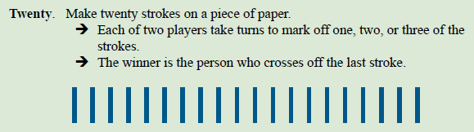
But first, a game
Notice any patterns?

Slide 4
Think-Pair-Share
With a partner, come up with:
3 ways we use percentages in our daily lives
2 jobs that regularly deal with percenatges
1 way they make our lives easier
Share with the class
WICOR

Slide 5

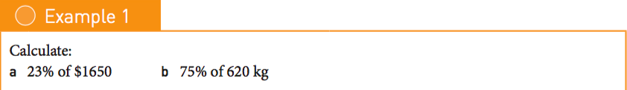
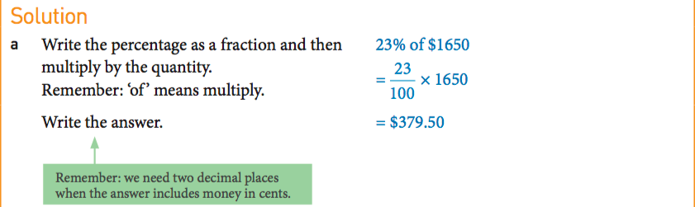
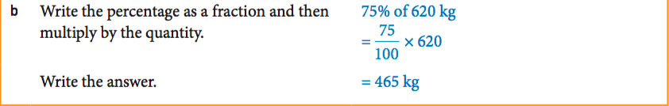
24
7
30
Percentage Skills Review
Date: 20/08/2018
EQ – What percentage skills are expected in Year 11 Essentials?
Finding a percentage of a quantity

Slide 6
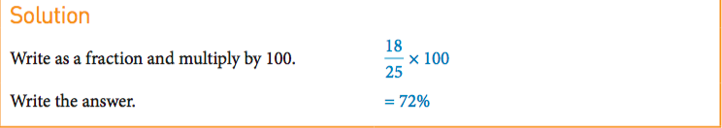
24
7
30
Percentages Skills Review
Date: 20/08/2018
EQ – What percentage skills are expected in Year 11 Essentials?
Expressing one quantity as a percentage of another

Slide 7

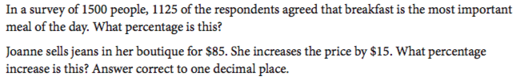
1)
2)
3)
4)

Slide 8
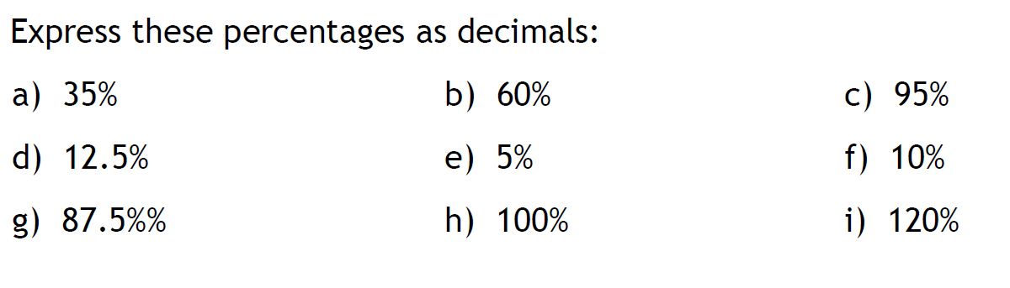
24
7
30
Percentage Skills Review
Date: 20/08/2018
EQ – What percentage skills are expected in Year 11 Essentials?
What are the steps required?

Slide 9
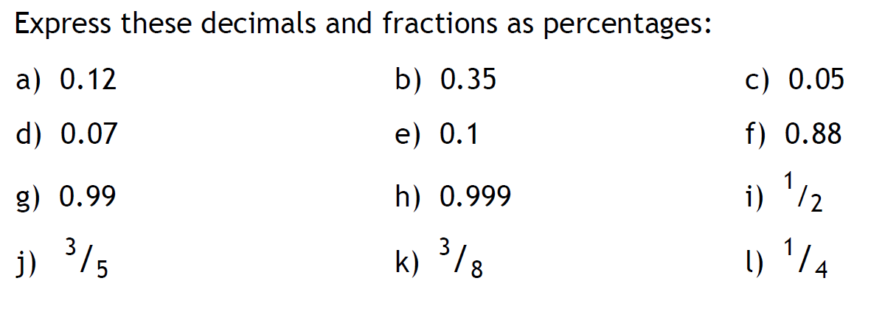
24
7
30
Percentage Skills Review
Date: 20/08/2018
EQ – What percentage skills are expected in Year 11 Essentials?
What are the steps required?

